Slide 1


Slide 2
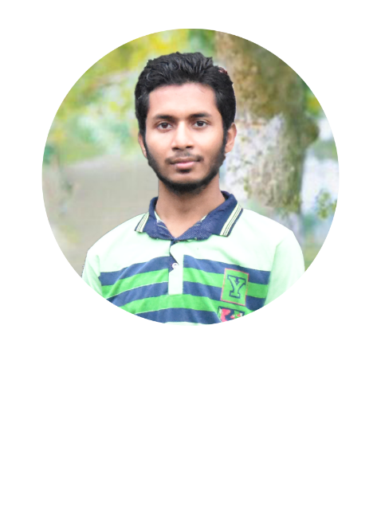
SUBRAT MEHER
15130V211034

Slide 3


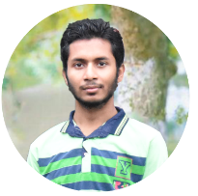
SUBRAT MEHER
15130V211034

Slide 4
What is the solution?
SUBRAT MEHER
15130V211034

Slide 5
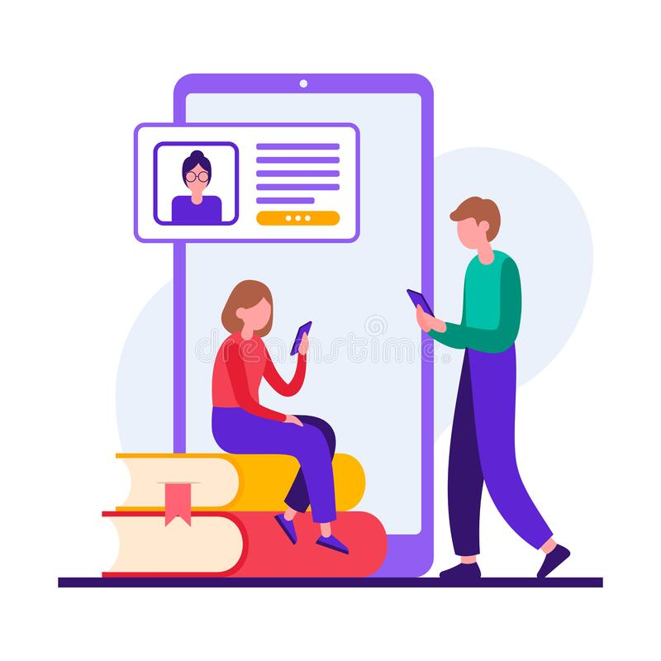

Go Online
SUBRAT MEHER
15130V211034

Slide 6
What can we do?
SUBRAT MEHER
15130V211034

Slide 7
A progressive platform to handle all these problems digitally.
SUBRAT MEHER
15130V211034

Slide 8
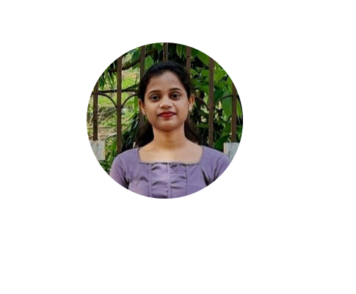
ALISHA NAYAK
15130V211002

Slide 9
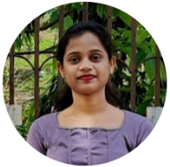
Lets start from a small part
ALISHA NAYAK
15130V211002

Slide 10
Analyse the requirements
Platform should be available to be used by all the students and teachers.
It should be easy to use.
It shouldn’t require any special hardware, it must work on all types of hardware
ALISHA NAYAK
15130V211002

Slide 11
What are the available solutions?
ALISHA NAYAK
15130V211002

Slide 12
Desktop Software
ALISHA NAYAK
15130V211002

Slide 13
Pros and cons of Desktop software
ALISHA NAYAK
15130V211002

Slide 14
Web Application
ALISHA NAYAK
15130V211002

Slide 15
Pros and cons of Web Application
ALISHA NAYAK
15130V211002

Slide 16
Mobile App
ALISHA NAYAK
15130V211002

Slide 17
Pros and cons of Mobile App
ALISHA NAYAK
15130V211002

Slide 18
Available Technology to develop Mobile App
Android Studio(Android)
Java/Kotlin
Xcode(IOS)
Objective-c/Swift
Xamarin(Android,IOS,Windows)
C#
React Native(Android, iOS, macOS, tvOS, Web, Windows)
Javascript
Flutter(Android, tvOS, iOS, Fuchsia, Android Watch, Web, Linux, macOS, ChromeOS, Windows)
Dart
ALISHA NAYAK
15130V211002

Slide 19
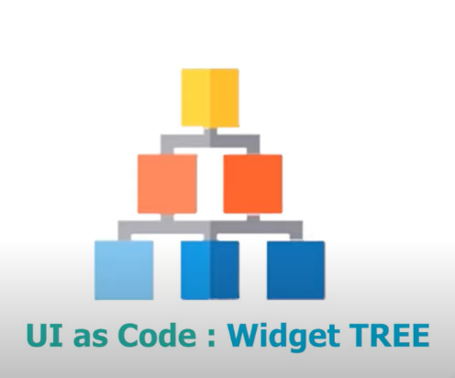
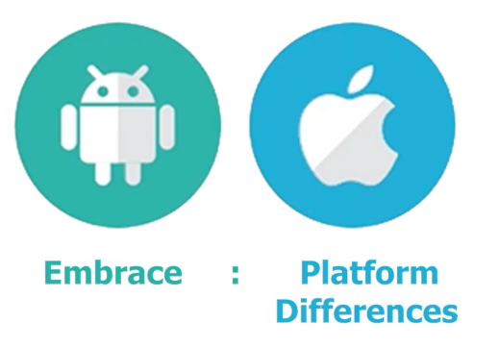
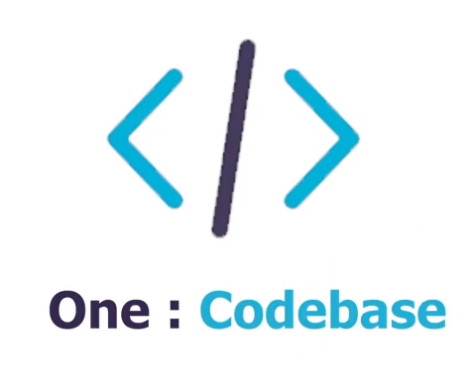
Why Flutter
Open source framework by google.
Uses single codebase to develop multi-platform application.
Compiles to ARM or Intel machine code
Gives control over every pixel.
UI code and Business Logic all can be developed using Dart.
ALISHA NAYAK
15130V211002

Slide 20

What is Firebase?
Backend-as-a-Service(BaaS)
High availability platform developed by Google.
Provides Services
Authentication
Database
Hosting
Cloud Function
ALISHA NAYAK
15130V211002

Slide 21

FIWI
ALISHA NAYAK
15130V211002

Slide 22
What is FIWI?
It’s a platform which provides the students and teachers a digital environment where some of their time and labour is reduced.
It’s developed with Flutter framework and uses Firebase as backend Solution.
ALISHA NAYAK
15130V211002

Slide 23
What does it offer?
ALISHA NAYAK
15130V211002

Slide 24

RASHMI NAIK
15130V211026

Slide 25
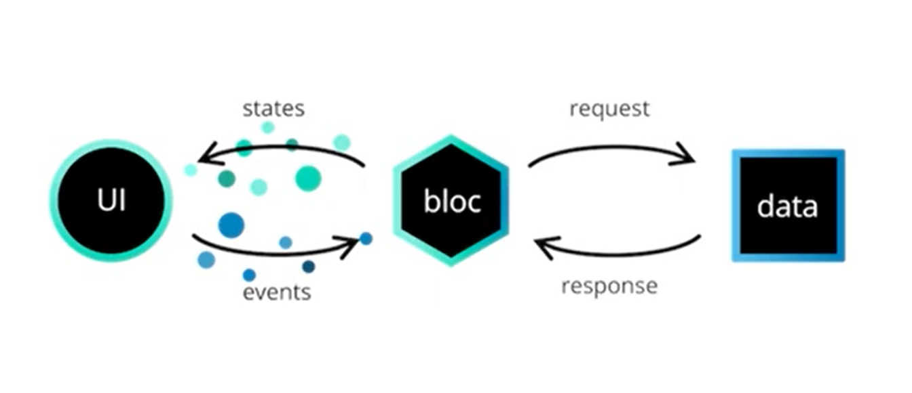

BLoC
Stands for Business Logic Component
RASHMI NAIK
15130V211026

Slide 26
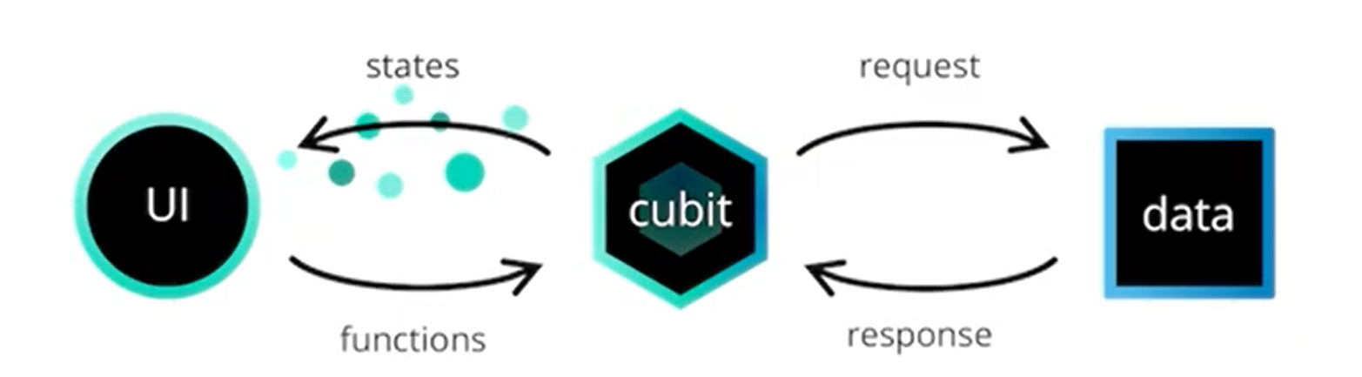
Cubit
Developed Over BloC
More simpler than BloC
RASHMI NAIK
15130V211026

Slide 27
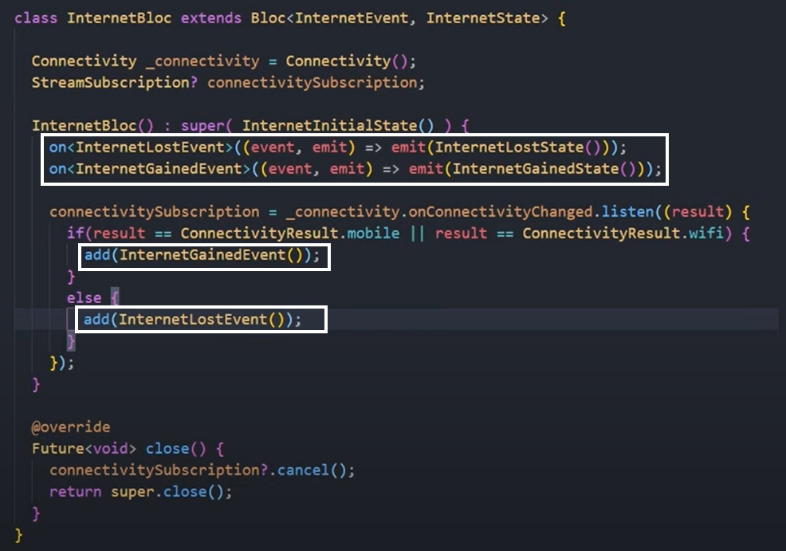
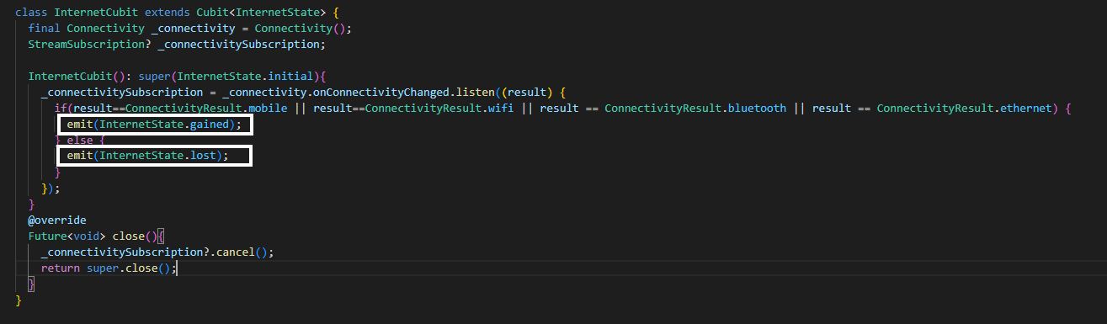
BLoC vs Cubit
RASHMI NAIK
15130V211026

Slide 28

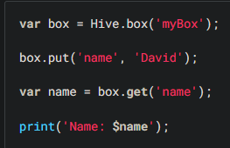
Hive
Store Data.
Blazing fast key-value database written in pure Dart.
Very Simple.
RASHMI NAIK
15130V211026

Slide 29
SUBRAT MEHER
15130V211034

Slide 30
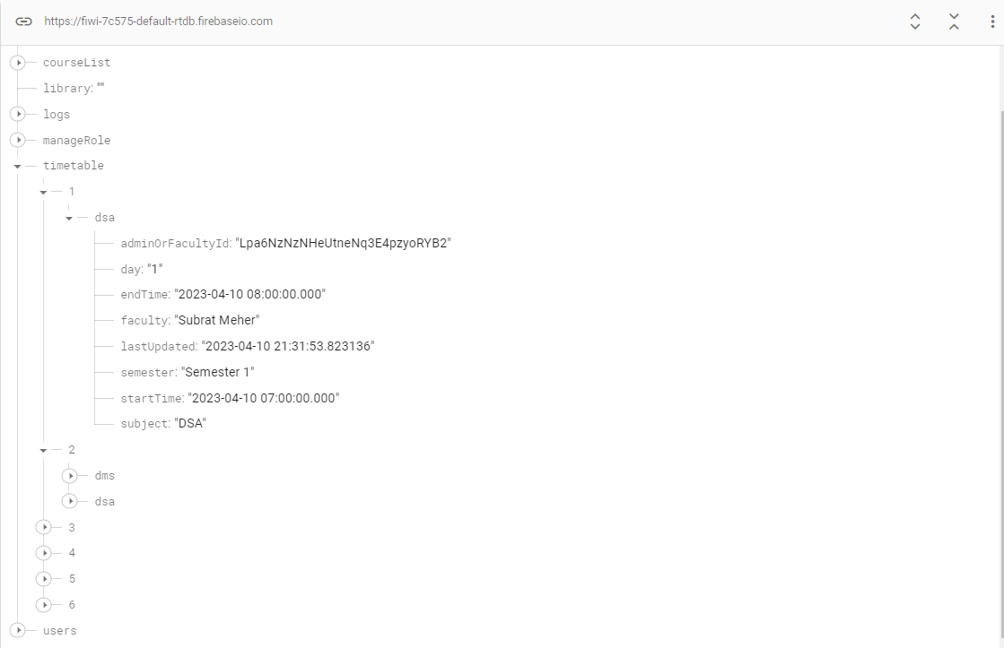
Firebase Realtime Database
NoSQL Database
Stored as Json tree
SUBRAT MEHER
15130V211034

Slide 31
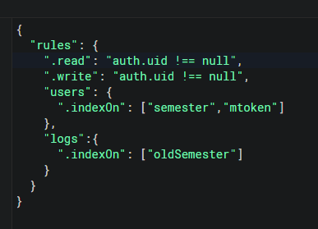
Firebase Realtime Database
Security Rules
SUBRAT MEHER
15130V211034

Slide 32
RASHMI NAIK
15130V211026

Slide 33
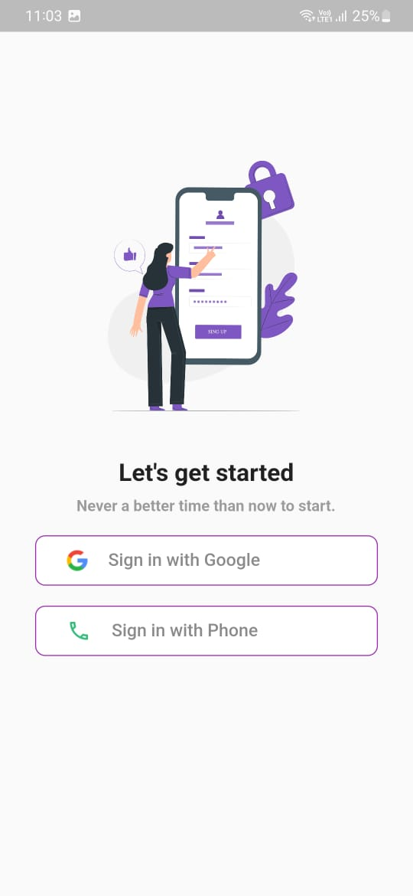
Login Screen
Authenticate With Google
Authenticate with Phone
RASHMI NAIK
15130V211026

Slide 34
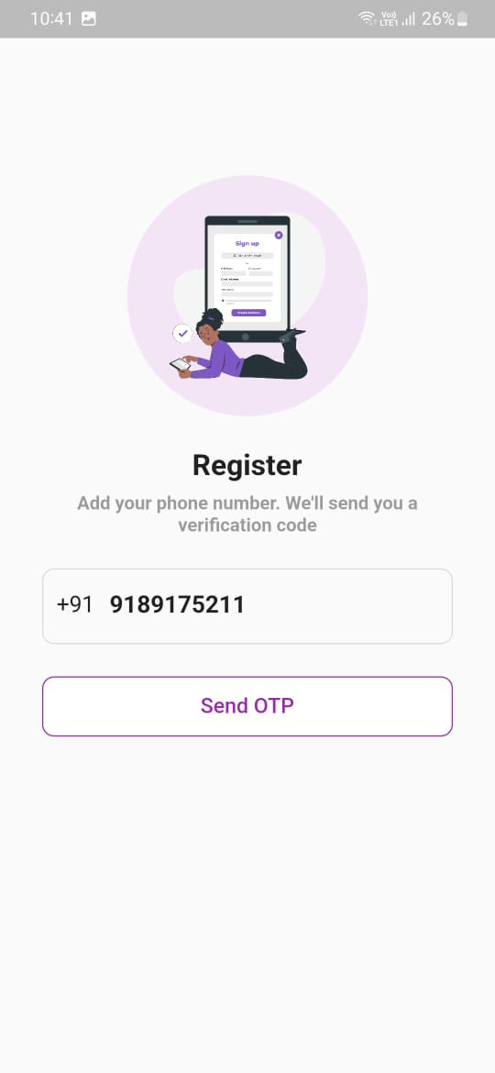
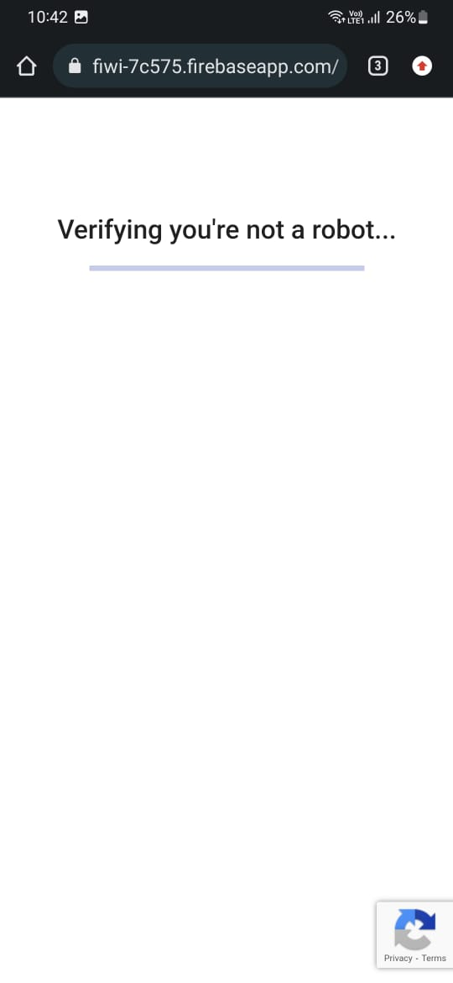
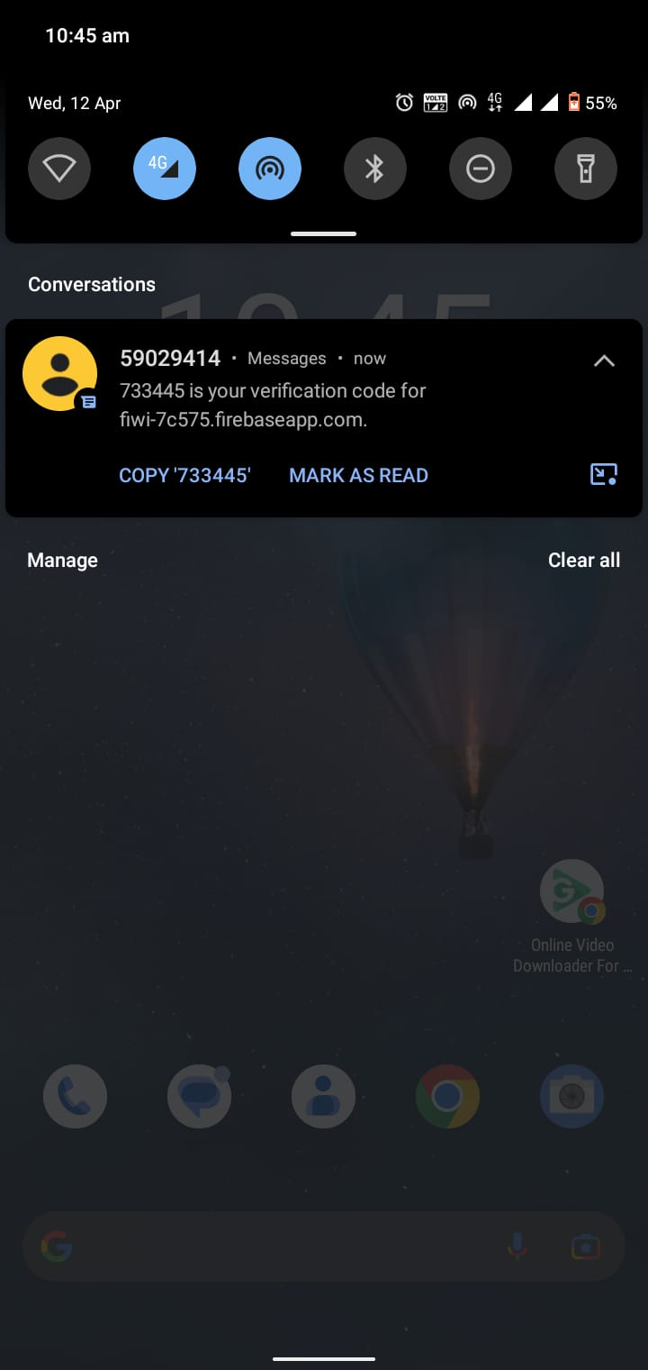
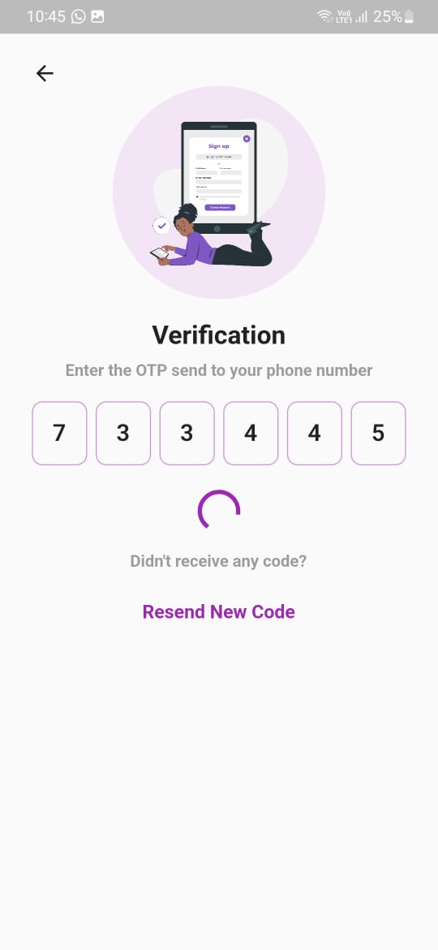
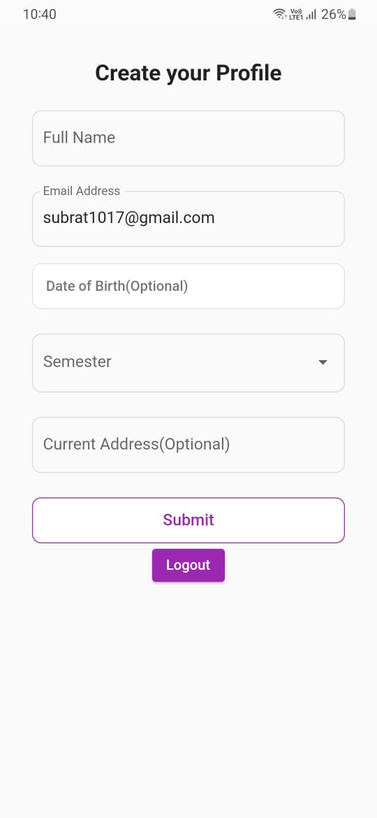

Sign in with Phone
RASHMI NAIK
15130V211026

Slide 35
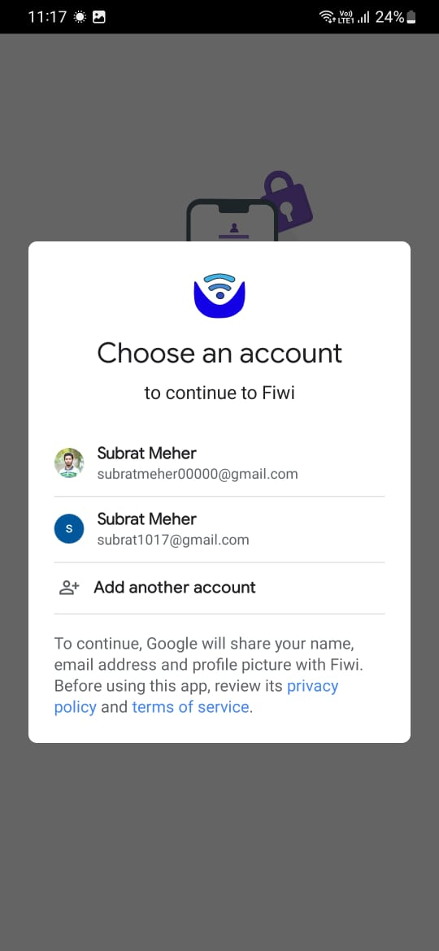
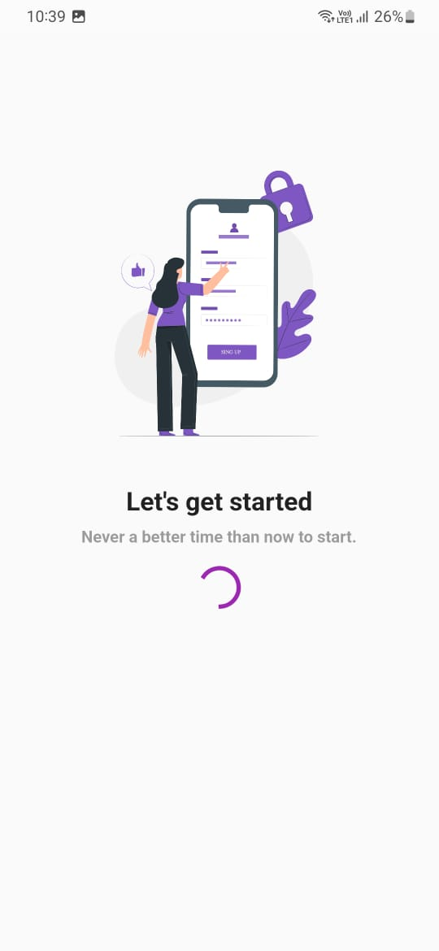
Sign in with Google
RASHMI NAIK
15130V211026

Slide 36

Security from Oursiders
RASHMI NAIK
15130V211026

Slide 37
ALISHA NAYAK
15130V211002

Slide 38
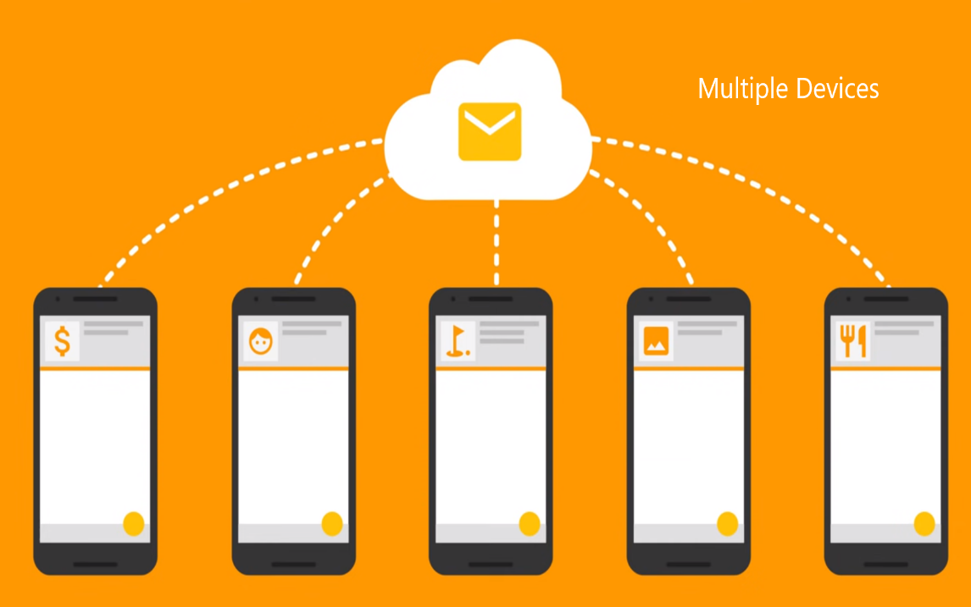
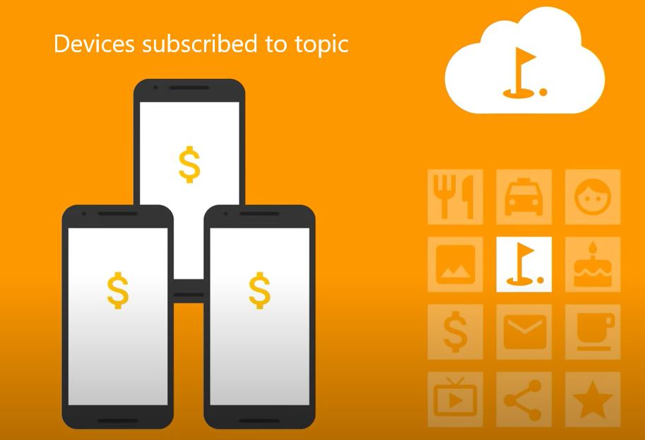
Notification
Cross platform messaging solution
Supports upto 4000 bytes data
ALISHA NAYAK
15130V211002

Slide 39
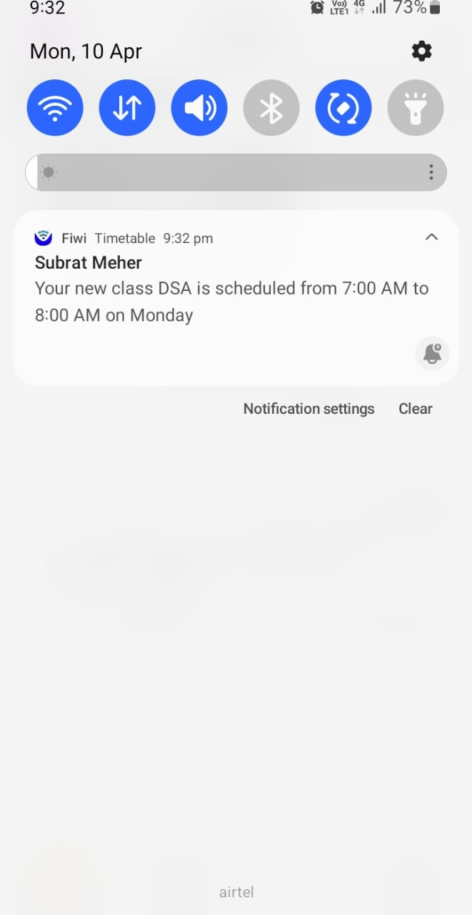
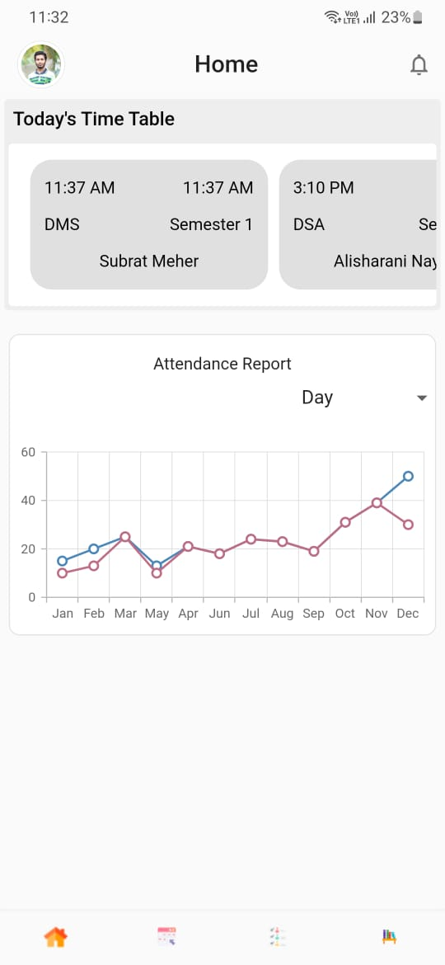
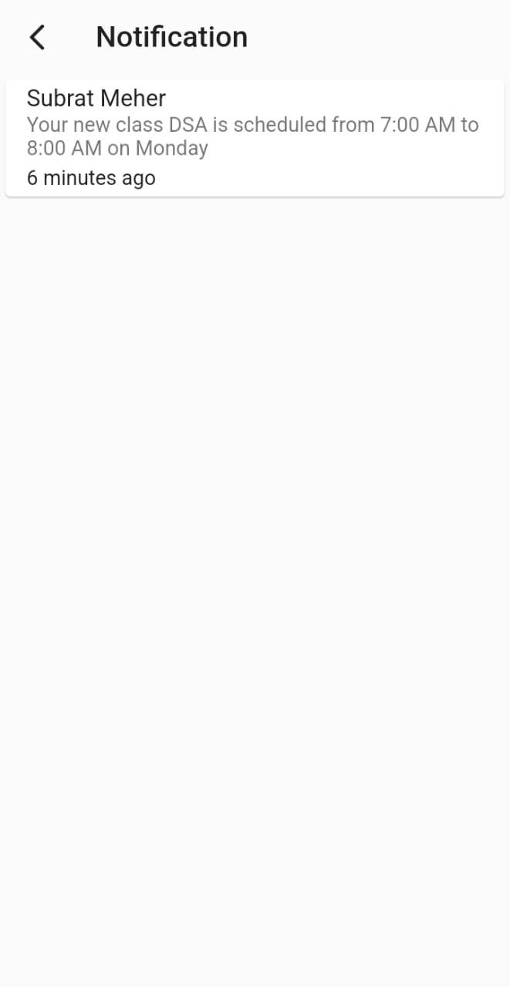
Fiwi notification
ALISHA NAYAK
15130V211002

Slide 40
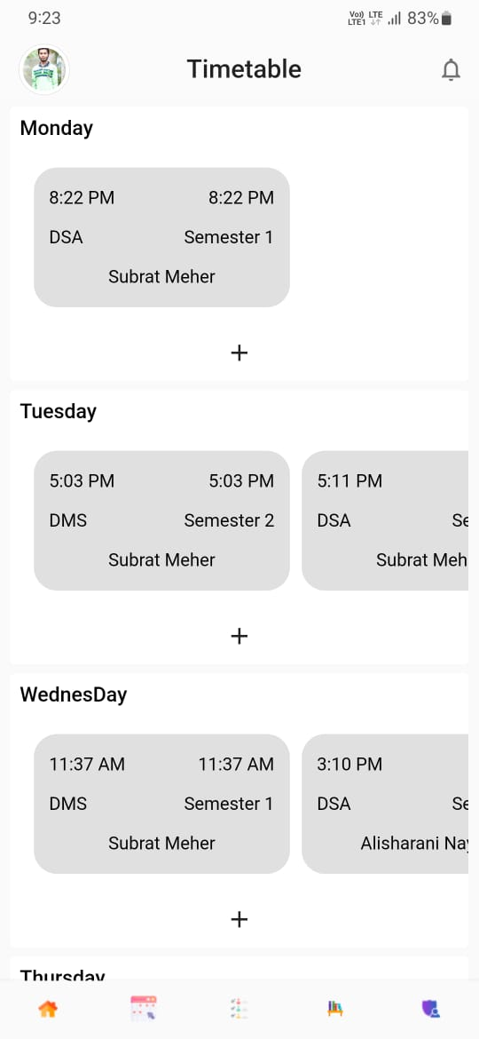
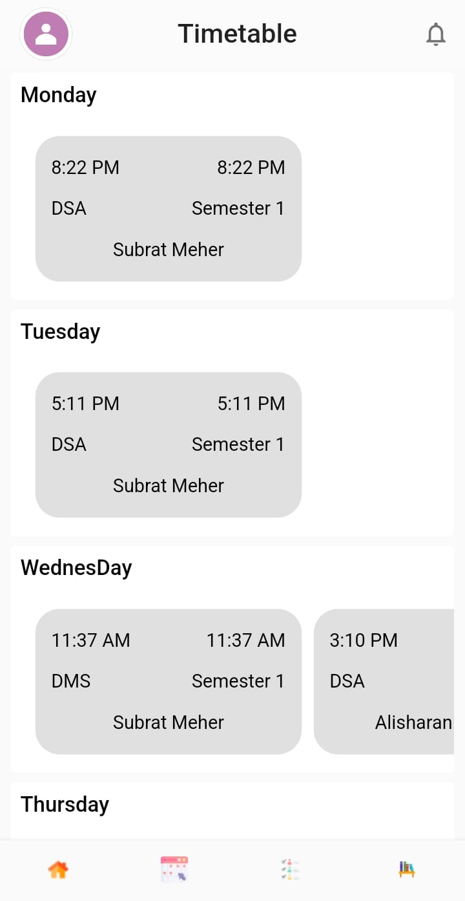
Timetable
View For Student
Student will see only their timetable
View For Admin and Faculty
ALISHA NAYAK
15130V211002

Slide 41
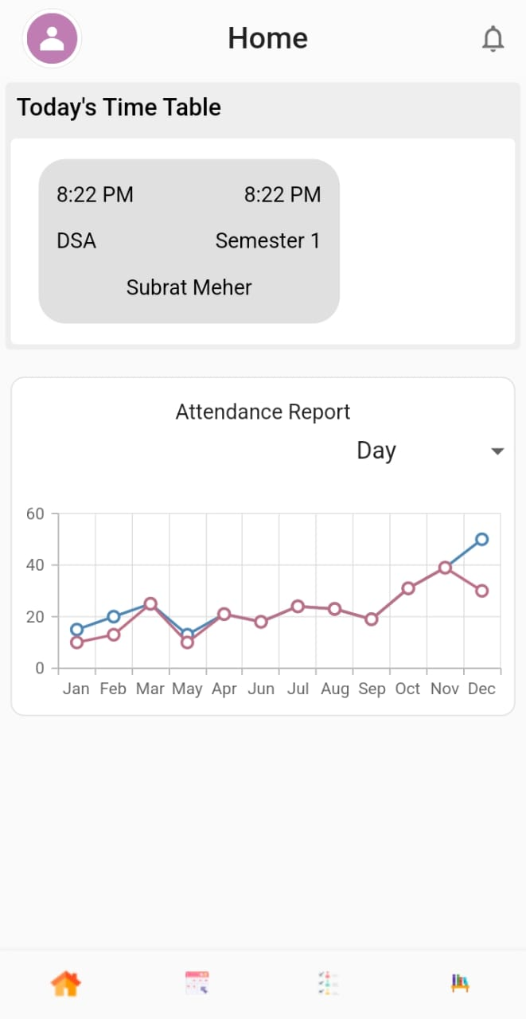
Timetable
Timetable will change dynamically with weekday
ALISHA NAYAK
15130V211002

Slide 42
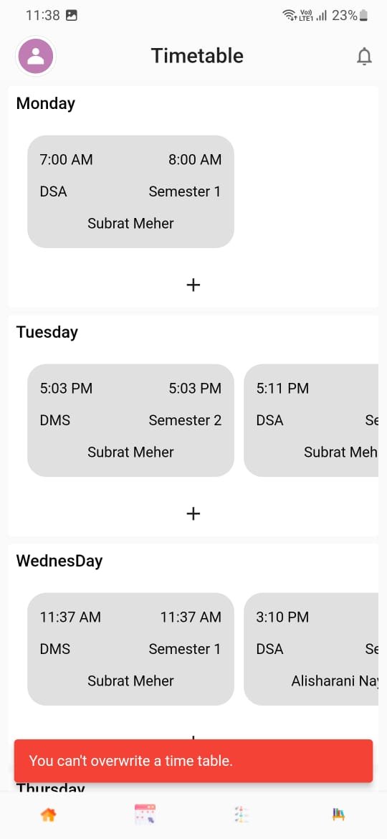
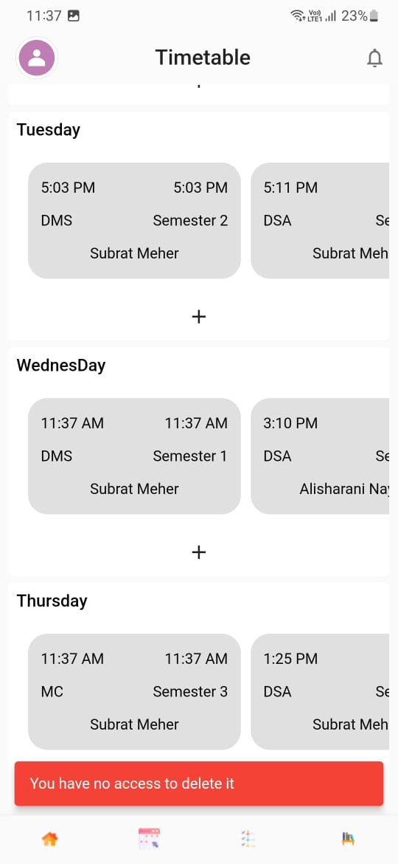
Timetable
Provide authorization based on role for admin and faculty
ALISHA NAYAK
15130V211002

Slide 43
SUBRAT MEHER
15130V211034

Slide 44
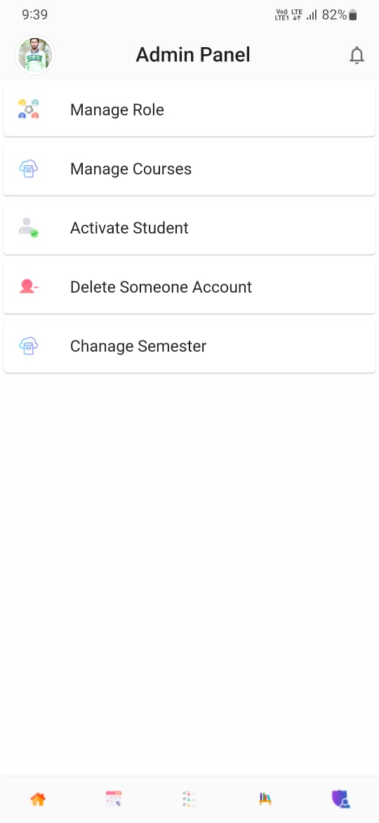
Admin Panel
SUBRAT MEHER
15130V211034

Slide 45
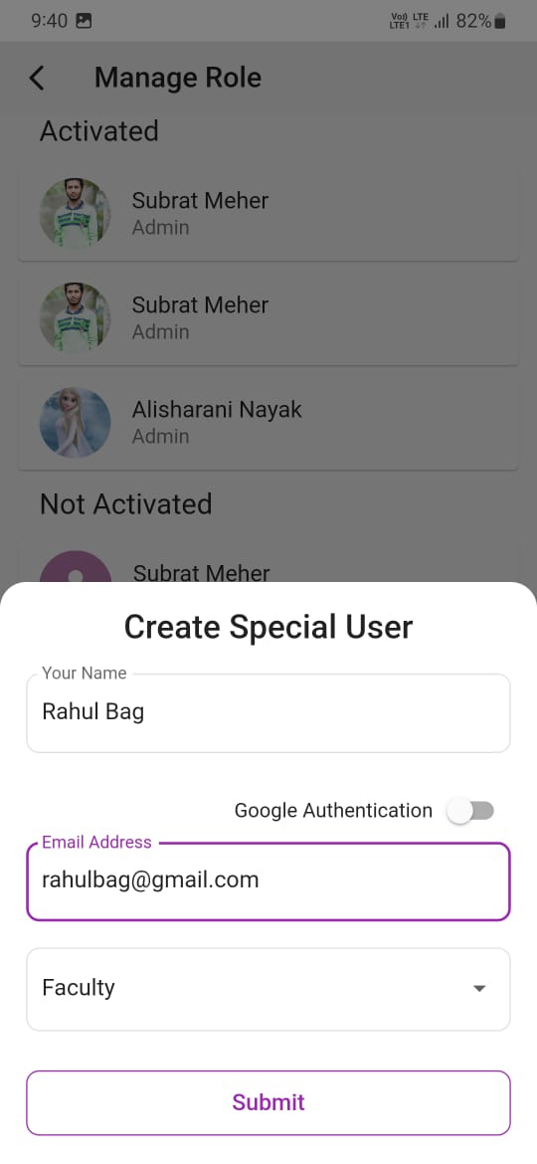
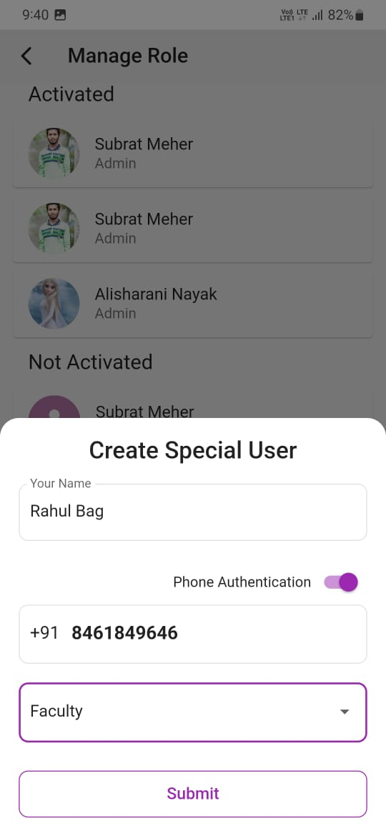
Manage Role
SUBRAT MEHER
15130V211034

Slide 46
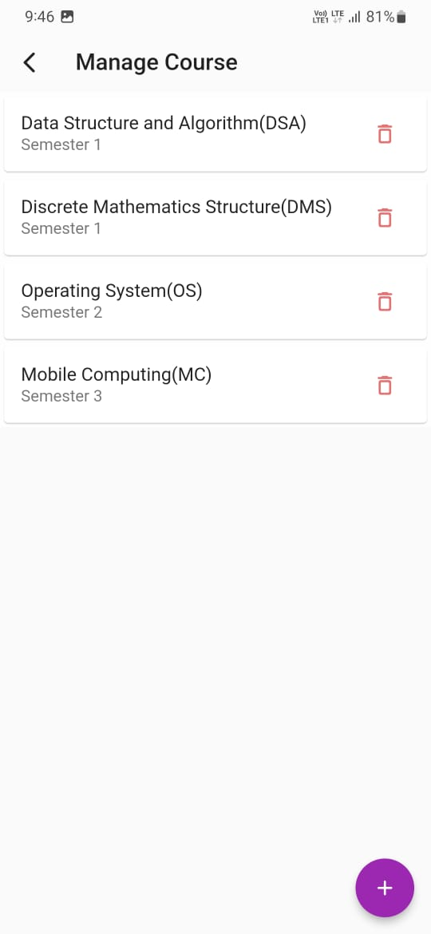
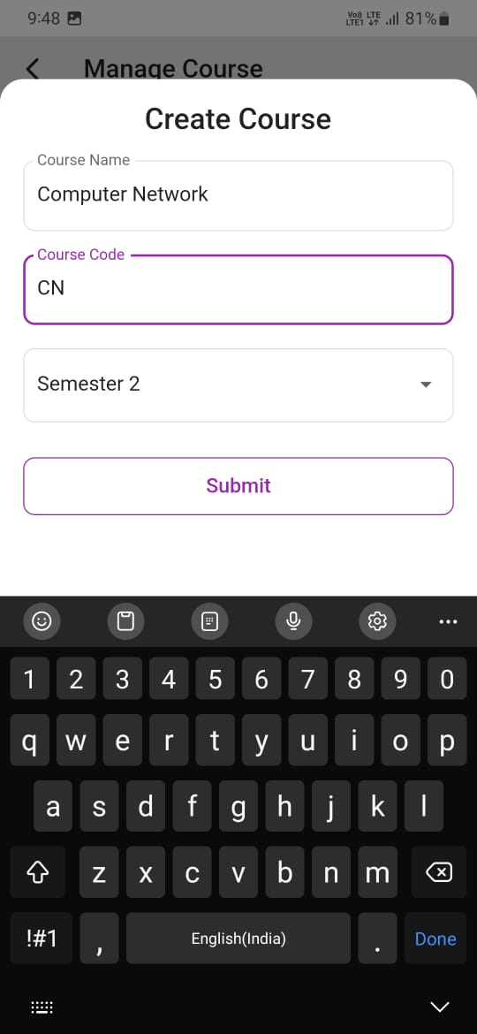

Manage Course
SUBRAT MEHER
15130V211034

Slide 47
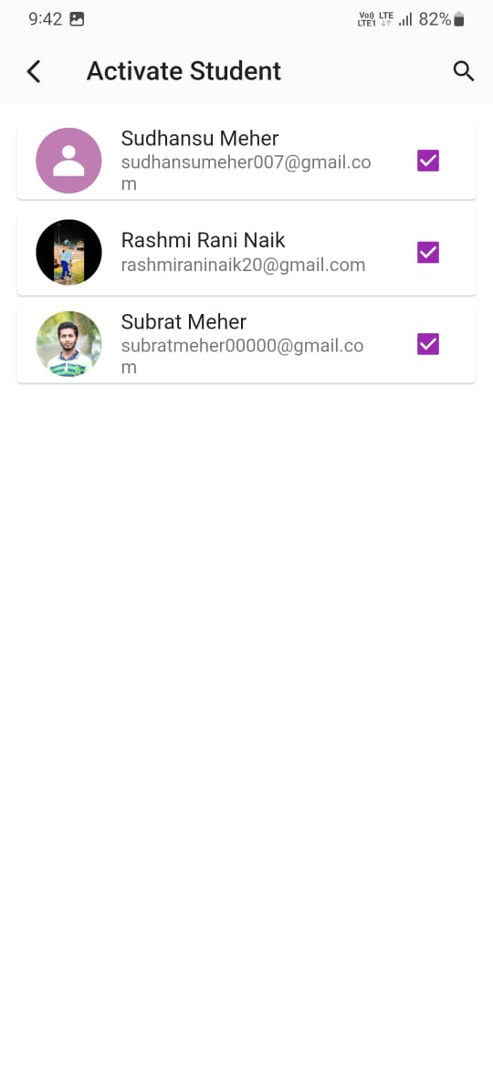
Activate Student
SUBRAT MEHER
15130V211034

Slide 48
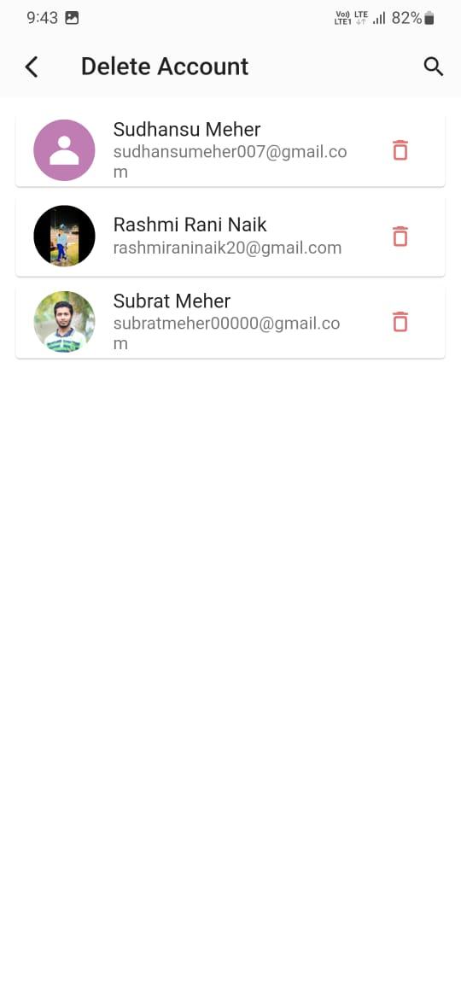
Delete Account
SUBRAT MEHER
15130V211034

Slide 49
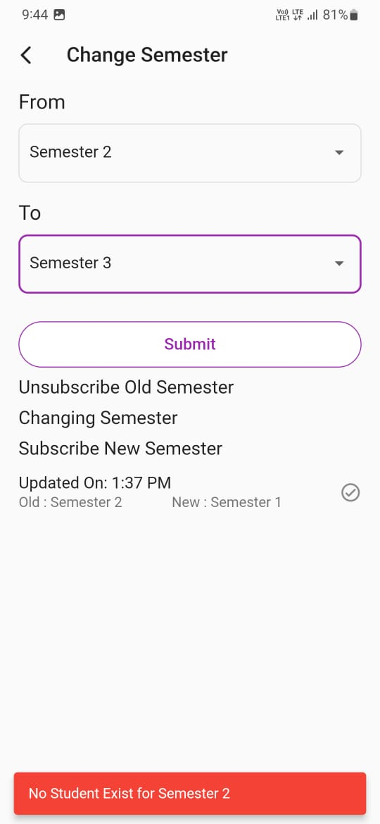
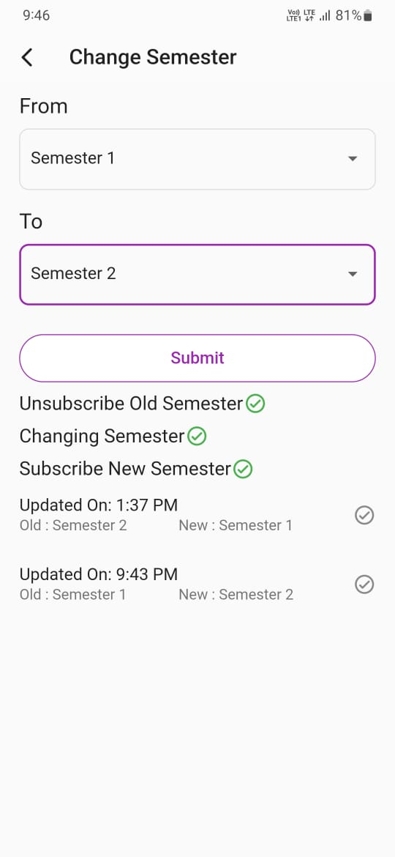
Change Semester
SUBRAT MEHER
15130V211034

Slide 50
What is the Future?
SUBRAT MEHER
15130V211034

